Slide 1

BIKE-SHARE CASE STUDY
GOOGLE ANALYTICS CAPSTONE PROJECT (29/05/2023)

Slide 2
CONTENT
Business Problem
Data findings
Recommendations

Slide 3
Business Objective
Cyclistic is a bike share company in Chicago with casual and annual members.
Come up with a digital marketing strategy to covert casual members to annual members.
By understanding these two types of users use cyclistic bikes differently.
Used data from the past 6 months.
Notes:
The future of the company depends on annual riders as they are more profitable.
6 months data instead of required 12 months due to memory issues on R studio.

Slide 4
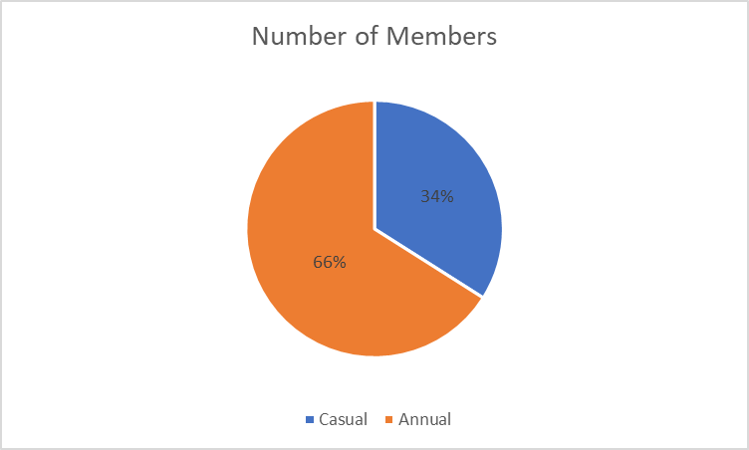
Notes:
66% annual
34% casual

Slide 5
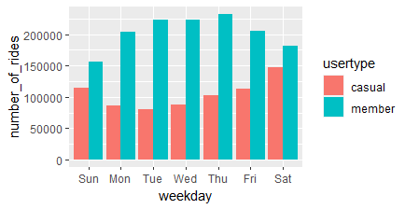
AVERAGE NUMBER OF RIDES FOR CASUAL RIDERS AND MEMBERS
Notes:
Annual riders take more rides compared to casual riders.

Slide 6
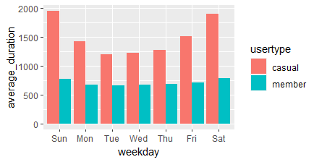
AVERAGE DURATION FOR CASUAL AND MEMBER RIDES
Notes:
Casual rides are longer than annual rides.

Slide 7
FINDINGS
Casual riders take longer but less rides compared to annual members
Casual riders use bikes throughout the week and annual rides should give them better cost or other advantages.

Slide 8
RECOMMENDATIONS
Limited offers to casual members to sign up as annual members.
Targeted marketing through emails and social media ads on interested clients.
Social media communities for casual embers to encourage more involvement
Gated resources and exclusive content
Personalized communication to guide casual members on how to upgrade.
Include the adverts for annual membership on the company’s social media pages.
Encourage annual members to sign up for referral programs and offer attractive incentives once they get casual members to sign up.
Notes:
Segmenting casual riders will make targeted marketing more efficient- more research will be necessary.
Gated resources could include discounted cycling gear, or training plans.
Use referral links– both members get discounts/other offers.

Slide 9
LIMITATIONS
No access to pricing.
Used 6 months data instead of 12 months because too much data couldn’t run.
Notes:
I could not determine if casual rides were more effective for the riders compared to annual member: In any case, the company could adjust the pricing model to make it ideal for both.

Slide 10

THE END

